Slide 1
Syntax Analyzer
Syntax Analyzer creates the syntactic structure of the given source program.
This syntactic structure is mostly a parse tree.
Syntax Analyzer is also known as parser.
The syntax of a programming is described by a context-free grammar (CFG). We will use BNF (Backus-Naur Form) notation in the description of CFGs.
The syntax analyzer (parser) checks whether a given source program satisfies the rules implied by a context-free grammar or not.
  If it satisfies, the parser creates the parse tree of that program.
  Otherwise the parser gives the error messages.
A context-free grammar
  gives a precise syntactic specification of a programming language.
  the design of the grammar is an initial phase of the design of a compiler.
  a grammar can be directly converted into a parser by some tools.
Syntax Analysis
Notes:
lec02-parserCFG

Slide 2
Parser
Parser works on a stream of tokens.
The smallest item is a token.
source
program
Lexical Analyzer
token
Parser
parse tree
get next token
Syntax Analysis

Slide 3
Parsers (cont.)
We categorize the parsers into two groups:
Top-Down Parser
  the parse tree is created top to bottom, starting from the root.
Bottom-Up Parser
  the parse is created bottom to top; starting from the leaves
Both top-down and bottom-up parsers scan the input from left to right (one symbol at a time).
Efficient top-down and bottom-up parsers can be implemented only for sub-classes of context-free grammars.
  LL for top-down parsing
  LR for bottom-up parsing
Syntax Analysis

Slide 4

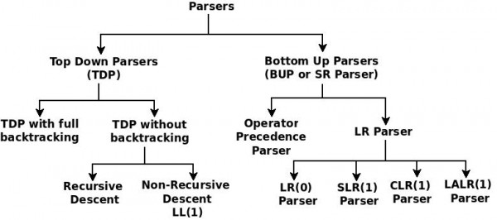
Parsers- Types
Syntax Analysis

Slide 5
Left Recursion
A grammar is left recursive if it has a non-terminal A such that there is a derivation.
A ⇒ Aα for some string α
Top-down parsing techniques cannot handle left-recursive grammars.
So, we have to convert our left-recursive grammar into an equivalent grammar which is not left-recursive.
The left-recursion may appear in a single step of the derivation (immediate left-recursion), or may appear in more than one step of the derivation.
Syntax Analysis

Slide 6
Immediate Left-Recursion
A → A α | β where β does not start with A
⇓ eliminate immediate left recursion
A → β A’
A’ → α A’ | ε an equivalent grammar
In general,
A → A α₁ | ... | A α_{m} | β₁ | ... | β_{n} where β₁ ... β_{n} do not start with A
⇓ eliminate immediate left recursion
A → β₁ A’ | ... | β_{n} A’
A’ → α₁ A’ | ... | α_{m} A’ | ε an equivalent grammar
Syntax Analysis

Slide 7
Immediate Left-Recursion -- Example
E → E+T | T
T → T*F | F
F → id | (E)
⇓ eliminate immediate left recursion
E → T E’
E’ → +T E’ | ε
T → F T’
T’ → *F T’ | ε
F → id | (E)
Syntax Analysis

Slide 8
Left-Recursion -- Problem
A grammar cannot be immediately left-recursive, but it still can be
left-recursive.
By just eliminating the immediate left-recursion, we may not get
a grammar which is not left-recursive.
S → Aa | b
A → Sc | d This grammar is not immediately left-recursive,
but it is still left-recursive.
S ⇒ Aa ⇒ Sca or
A ⇒ Sc ⇒ Aac causes to a left-recursion
So, we have to eliminate all left-recursions from our grammar
Syntax Analysis

Slide 9
Eliminate Left-Recursion -- Algorithm
- Arrange non-terminals in some order: A₁ ... A_{n}
- for i from 1 to n do {
- for j from 1 to i-1 do {
replace each production
A_{i} → A_{j} γ
by
A_{i} → α₁ γ | ... | α_{k} γ
where A_{j} → α₁ | ... | α_{k}
}
- eliminate immediate left-recursions among A_{i} productions
}
Syntax Analysis

Slide 10
Eliminate Left-Recursion -- Example
S → Aa | b
A → Ac | Sd | f
- Order of non-terminals: S, A
for S:
- we do not enter the inner loop.
- there is no immediate left recursion in S.
for A:
- Replace A → Sd with A → Aad | bd
So, we will have A → Ac | Aad | bd | f
- Eliminate the immediate left-recursion in A
A → bdA’ | fA’
A’ → cA’ | adA’ | ε
So, the resulting equivalent grammar which is not left-recursive is:
S → Aa | b
A → bdA’ | fA’
A’ → cA’ | adA’ | ε
Syntax Analysis

Slide 11
Eliminate Left-Recursion – Example2
S → Aa | b
A → Ac | Sd | f
- Order of non-terminals: A, S
for A:
- we do not enter the inner loop.
- Eliminate the immediate left-recursion in A
A → SdA’ | fA’
A’ → cA’ | ε
for S:
- Replace S → Aa with S → SdA’a | fA’a
So, we will have S → SdA’a | fA’a | b
- Eliminate the immediate left-recursion in S
S → fA’aS’ | bS’
S’ → dA’aS’ | ε
So, the resulting equivalent grammar which is not left-recursive is:
S → fA’aS’ | bS’
S’ → dA’aS’ | ε
A → SdA’ | fA’
A’ → cA’ | ε
Syntax Analysis

Slide 12
Left-Factoring
A predictive parser (a top-down parser without backtracking) insists that the grammar must be left-factored.
grammar ➔ a new equivalent grammar suitable for predictive parsing
stmt → if expr then stmt else stmt |
if expr then stmt
when we see if, we cannot know which production rule to choose to re-write stmt in the derivation.
Syntax Analysis

Slide 13
Left-Factoring (cont.)
In general,
A → αβ₁ | αβ₂ where α is non-empty and the first symbols
of β₁ and β₂ (if they have one)are different.
when processing α we cannot know whether expand
A to αβ₁ or
A to αβ₂
But, if we re-write the grammar as follows
A → αA’
A’ → β₁ | β₂ so, we can immediately expand A to αA’
Syntax Analysis

Slide 14
Left-Factoring -- Algorithm
For each non-terminal A with two or more alternatives (production rules) with a common non-empty prefix, let say
A → αβ₁ | ... | αβ_{n} | γ₁ | ... | γ_{m}
convert it into
A → αA’ | γ₁ | ... | γ_{m}
A’ → β₁ | ... | β_{n}
Syntax Analysis

Slide 15
Left-Factoring – Example1
A → abB | aB | cdg | cdeB | cdfB
⇓
A → aA’ | cdg | cdeB | cdfB
A’ → bB | B
⇓
A → aA’ | cdA’’
A’ → bB | B
A’’ → g | eB | fB
Syntax Analysis

Slide 16
Left-Factoring – Example2
A → ad | a | ab | abc | b
⇓
A → aA’ | b
A’ → d | ε | b | bc
⇓
A → aA’ | b
A’ → d | ε | bA’’
A’’ → ε | c
Syntax Analysis

Slide 17
Non-Recursive Predictive Parsing -- LL(1) Parser
Non-Recursive predictive parsing is a table-driven parser.
It is a top-down parser.
It is also known as LL(1) Parser.
The first L means the input string is processed from left to right. The second L means the derivation will be a leftmost derivation (the leftmost variable is replaced at each step).
input buffer
stack Non-recursive output
Predictive Parser
Parsing Table
Syntax Analysis

Slide 18
LL(1) Parser
input buffer
  our string to be parsed. We will assume that its end is marked with a special symbol $.
output
  a production rule representing a step of the derivation sequence (left-most derivation) of the string in the input buffer.
stack
  contains the grammar symbols
  at the bottom of the stack, there is a special end marker symbol $.
  initially the stack contains only the symbol $ and the starting symbol S. $S ⬅ initial stack
  when the stack is emptied (ie. only $ left in the stack), the parsing is completed.
parsing table
  a two-dimensional array M[A,a]
  each row is a non-terminal symbol
  each column is a terminal symbol or the special symbol $
  each entry holds a production rule.
Syntax Analysis

Slide 19
LL(1) Parser – Parser Actions
The symbol at the top of the stack (say X) and the current symbol in the input string (say a) determine the parser action.
There are four possible parser actions.
If X and a are $ ➔ parser halts (successful completion)
If X and a are the same terminal symbol (different from $)
➔ parser pops X from the stack, and moves the next symbol in the input buffer.
If X is a non-terminal
➔ parser looks at the parsing table entry M[X,a]. If M[X,a] holds a production rule X→Y₁Y₂...Y_{k}, it pops X from the stack and pushes Y_{k},Y_{k-1},...,Y₁ into the stack. The parser also outputs the production rule X→Y₁Y₂...Y_{k} to represent a step of the derivation.
none of the above ➔ error
  all empty entries in the parsing table are errors.
  If X is a terminal symbol different from a, this is also an error case.
Syntax Analysis

Slide 20
LL(1) Parser – Example1
S → aBa LL(1) Parsing
B → bB | ε Table
stack input output
$S abba$ S → aBa
$aBa abba$
$aB bba$ B → bB
$aBb bba$
$aB ba$ B → bB
$aBb ba$
$aB a$ B → ε
$a a$
$ $ accept, successful completion
 | a | b | $
S | S → aBa
B | B → ε | B → bB
Syntax Analysis

Slide 21
LL(1) Parser – Example1 (cont.)
Outputs: S → aBa B → bB B → bB B → ε
Derivation(left-most): S⇒aBa⇒abBa⇒abbBa⇒abba
S
parse tree
a
B
a
b
B
b
B
ε
Syntax Analysis

Slide 22
LL(1) Parser – Example2
E → TE’
E’ → +TE’ | ε
T → FT’
T’ → *FT’ | ε
F → (E) | id
 | id | + | * | ( | ) | $
E | E → TE’ |  |  | E → TE’
E’ |  | E’ → +TE’ |  |  | E’ → ε | E’ → ε
T | T → FT’ |  |  | T → FT’
T’ |  | T’ → ε | T’ → *FT’ |  | T’ → ε | T’ → ε
F | F → id |  |  | F → (E)
Syntax Analysis

Slide 23
LL(1) Parser – Example2
stack input output
$E id+id$ E → TE’
$E’T id+id$ T → FT’
$E’ T’F id+id$ F → id
$ E’ T’id id+id$
$ E’ T’ +id$ T’ → ε
$ E’ +id$ E’ → +TE’
$ E’ T+ +id$
$ E’ T id$ T → FT’
$ E’ T’ F id$ F → id
$ E’ T’id id$
$ E’ T’ $ T’ → ε
$ E’ $ E’ → ε
$ $ accept
Syntax Analysis

Slide 24
Constructing LL(1) Parsing Tables
Two functions are used in the construction of LL(1) parsing tables:
  FIRST FOLLOW
FIRST(α) is a set of the terminal symbols which occur as first symbols in strings derived from α where α is any string of grammar symbols.
if α derives to ε, then ε is also in FIRST(α) .
FOLLOW(A) is the set of the terminals which occur immediately after (follow) the non-terminal A in the strings derived from the starting symbol.
  a terminal a is in FOLLOW(A) if S ⇒ αAaβ
  $ is in FOLLOW(A) if S ⇒ αA
*
*
Syntax Analysis

Slide 25
Compute FIRST for Any String X
If X is a terminal symbol ➔ FIRST(X)={X}
If X is a non-terminal symbol and X → ε is a production rule ➔ ε is in FIRST(X).
If X is a non-terminal symbol and X → Y₁Y₂..Y_{n} is a production rule ➔ if a terminal a in FIRST(Y_{i}) and ε is in all FIRST(Y_{j}) for j=1,...,i-1 then a is in FIRST(X). ➔ if ε is in all FIRST(Y_{j}) for j=1,...,n then ε is in FIRST(X).
If X is ε ➔ FIRST(X)={ε}
Given any non-terminal of a CFG, if we derive all the possible strings from it, the first terminal(s) is the FIRST() of the non-terminal.
S → aABC
A →b
B →c
C →d
FIRST(S): a
FIRST(A): b
FIRST(B):c
FIRST(C):d
Syntax Analysis

Slide 26
FIRST Example
E → TE’
E’ → +TE’ | ε
T → FT’
T’ → *FT’ | ε
F → (E) | id
FIRST(F) = {(,id} FIRST(TE’) = {(,id}
FIRST(T’) = {*, ε} FIRST(+TE’ ) = {+}
FIRST(T) = {(,id} FIRST(ε) = {ε}
FIRST(E’) = {+, ε} FIRST(FT’) = {(,id}
FIRST(E) = {(,id} FIRST(*FT’) = {*}
FIRST(ε) = {ε}
FIRST((E)) = {(}
FIRST(id) = {id}
Syntax Analysis

Slide 27
Compute FOLLOW (for non-terminals)
If S is the start symbol ➔ $ is in FOLLOW(S)
if A → αBβ is a production rule ➔ everything in FIRST(β) is FOLLOW(B) except ε
If ( A → αB is a production rule ) or ( A → αBβ is a production rule and ε is in FIRST(β) ) ➔ everything in FOLLOW(A) is in FOLLOW(B).
We apply these rules until nothing more can be added to any follow set.
During the process of derivation, the terminal(s) that could follow the non-terminal are to be considered as FOLLOW() of the non-terminal.
S →ABC
A →a
B →b| ε
C →c
FOLLOW(S): {$}
FOLLOW(A): {b,c}
FOLLOW(B): {c}
FOLLOW(C):{$}
Syntax Analysis

Slide 28
FOLLOW Example
E → TE’
E’ → +TE’ | ε
T → FT’
T’ → *FT’ | ε
F → (E) | id
FOLLOW(E) = { $, ) }
FOLLOW(E’) = { $, ) }
FOLLOW(T) = { +, ), $ }
FOLLOW(T’) = { +, ), $ }
FOLLOW(F) = {+, *, ), $ }
FOLLOW(T)=FIRST(E ’)={+, ), $)
The following terminal symbol will be selected as FOLLOW.
The FIRST of the following non-terminal will be selected as FOLLOW.
If it is right most in the RHS, the FOLLOW of the LHS will be selected
Note: FOLLOW() doesn’t include ‘ε’
Syntax Analysis

Slide 29
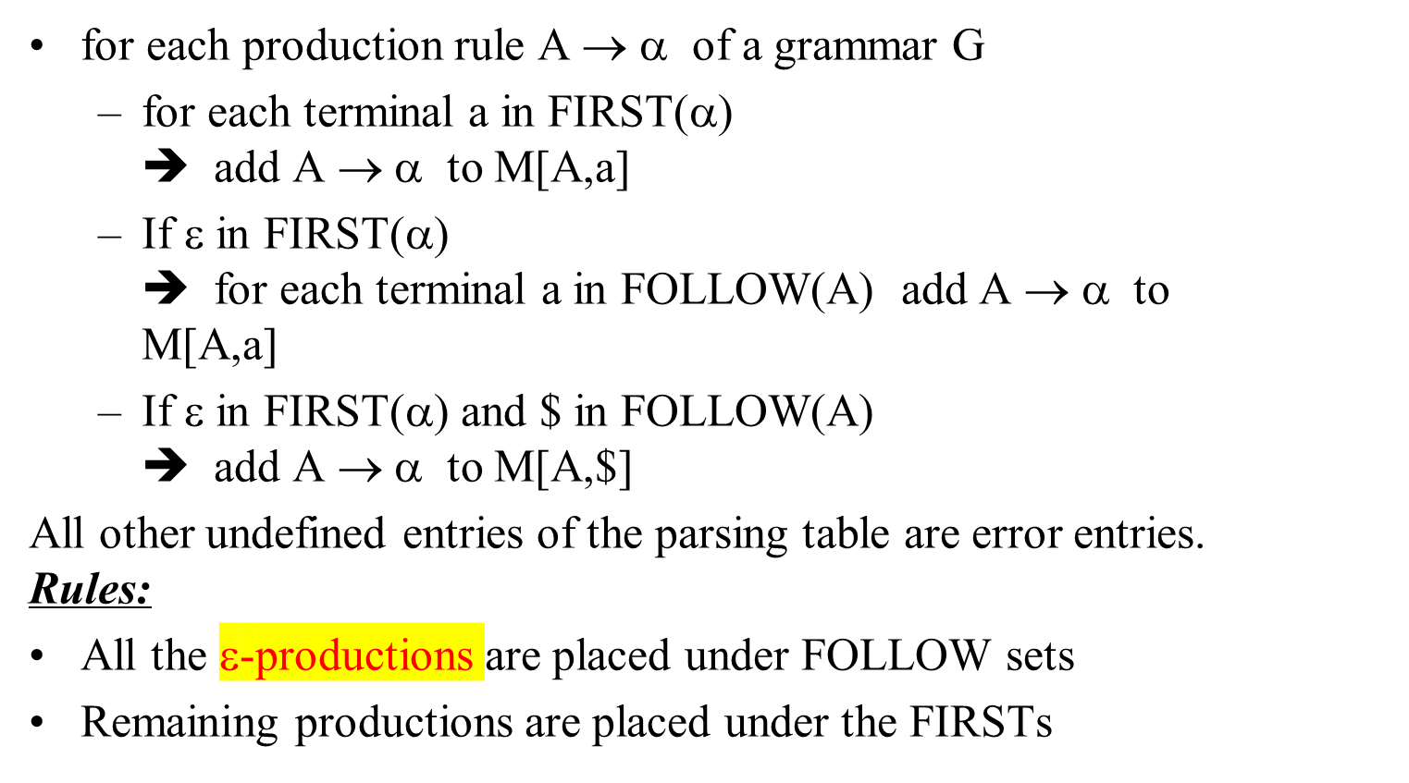
Constructing LL(1) Parsing Table -- Algorithm
Syntax Analysis

Slide 30
Constructing LL(1) Parsing Table -- Example
E → TE’ FIRST(TE’)={(,id} ➔ E → TE’ into M[E,(] and M[E,id]
E’ → +TE’ FIRST(+TE’ )={+} ➔ E’ → +TE’ into M[E’,+]
E’ → ε FIRST(ε)={ε} ➔ none
but since ε in FIRST(ε)
and FOLLOW(E’)={$,)} ➔ E’ → ε into M[E’,$] and M[E’,)]
T → FT’ FIRST(FT’)={(,id} ➔ T → FT’ into M[T,(] and M[T,id]
T’ → *FT’ FIRST(*FT’ )={*} ➔ T’ → *FT’ into M[T’,*]
T’ → ε FIRST(ε)={ε} ➔ none
but since ε in FIRST(ε)
and FOLLOW(T’)={$,),+} ➔ T’ → ε into M[T’,$], M[T’,)] and M[T’,+]
F → (E) FIRST((E) )={(} ➔ F → (E) into M[F,(]
F → id FIRST(id)={id} ➔ F → id into M[F,id]
Syntax Analysis

Slide 31
LL(1) Grammars
A grammar whose parsing table has no multiply-defined entries is said to be LL(1) grammar.
one input symbol used as a look-head symbol do determine parser action
LL(1) left most derivation
input scanned from left to right
The parsing table of a grammar may contain more than one production rule. In this case, we say that it is not a LL(1) grammar.
Syntax Analysis

Slide 32
A Grammar which is not LL(1)
S → i C t S E | a FOLLOW(S) = { $,e }
E → e S | ε FOLLOW(E) = { $,e }
C → b FOLLOW(C) = { t }
FIRST(iCtSE) = {i}
FIRST(a) = {a}
FIRST(eS) = {e}
FIRST(ε) = {ε}
FIRST(b) = {b}
two production rules for M[E,e]
Problem ➔ ambiguity
 | a | b | e | i | t | $
S | S → a |  |  | S → iCtSE
E |  |  | E → e S E → ε |  |  | E → ε
C |  | C → b
Syntax Analysis

Slide 33
A Grammar which is not LL(1) (cont.)
What do we have to do it if the resulting parsing table contains multiply defined entries?
  If we didn’t eliminate left recursion, eliminate the left recursion in the grammar.
  If the grammar is not left factored, we have to left factor the grammar.
  If its (new grammar’s) parsing table still contains multiply defined entries, that grammar is ambiguous or it is inherently not a LL(1) grammar.
A left recursive grammar cannot be a LL(1) grammar.
  A → Aα | β
    any terminal that appears in FIRST(β) also appears FIRST(Aα) because Aα ⇒ βα.
    If β is ε, any terminal that appears in FIRST(α) also appears in FIRST(Aα) and FOLLOW(A).
A grammar is not left factored, it cannot be a LL(1) grammar
  A → αβ₁ | αβ₂
    any terminal that appears in FIRST(αβ₁) also appears in FIRST(αβ₂).
An ambiguous grammar cannot be a LL(1) grammar.
Syntax Analysis

Slide 34
Properties of LL(1) Grammars
A grammar G is LL(1) if and only if the following conditions hold for two distinctive production rules A → α and A → β
  Both α and β cannot derive strings starting with same terminals.
  At most one of α and β can derive to ε.
  If β can derive to ε, then α cannot derive to any string starting with a terminal in FOLLOW(A).
Syntax Analysis

Slide 35
Error Recovery in Predictive Parsing
An error may occur in the predictive parsing (LL(1) parsing)
  if the terminal symbol on the top of stack does not match with the current input symbol.
  if the top of stack is a non-terminal A, the current input symbol is a, and the parsing table entry M[A,a] is empty.
What should the parser do in an error case?
  The parser should be able to give an error message (as much as possible meaningful error message).
  It should be recover from that error case, and it should be able to continue the parsing with the rest of the input.
Syntax Analysis

Slide 36
Error Recovery Techniques
Panic-Mode Error Recovery
  Skipping the input symbols until a synchronizing token is found.
Phrase-Level Error Recovery
  Each empty entry in the parsing table is filled with a pointer to a specific error routine to take care of that error case.
Syntax Analysis

Slide 37
Panic-Mode Error Recovery in LL(1) Parsing
In panic-mode error recovery, we skip all the input symbols until a synchronizing token is found.
What is the synchronizing token?
  All the terminal-symbols in the follow set of a non-terminal can be used as a synchronizing token set for that non-terminal.
So, a simple panic-mode error recovery for the LL(1) parsing:
  All the empty entries are marked as synch to indicate that the parser will skip all the input symbols until a symbol in the follow set of the non-terminal A which is on the top of the stack. Then the parser will pop that non-terminal A from the stack. The parsing continues from that state.
  To handle unmatched terminal symbols, the parser pops that unmatched terminal symbol from the stack and it issues an error message saying that unmatched terminal is inserted.
Syntax Analysis

Slide 38
Panic-Mode Error Recovery - Example
 | a | b | c | d | e | $
S | S → AbS | sync | S → AbS | sync | S → e | S → ε
A | A → a | sync | A → cAd | sync | sync | sync
S → AbS | e | ε
A → a | cAd
FOLLOW(S)={$}
FOLLOW(A)={b,d}
stack input output stack input output
$S aab$ S → AbS $S ceadb$ S → AbS
$SbA aab$ A → a $SbA ceadb$ A → cAd
$Sba aab$ $SbdAc ceadb$
$Sb ab$ Error: unmatched b, inserted $SbdA eadb$ Error:unexpected e (illegal A)
$S ab$ S → AbS (Remove all input tokens until first b or d, pop A)
$SbA ab$ A → a $Sbd db$
$Sba ab$ $Sb b$
$Sb b$ $S $ S → ε
$S $ S → ε $ $ accept
$ $ accept
Syntax Analysis

Slide 39
Phrase-Level Error Recovery
Each empty entry in the parsing table is filled with a pointer to a special error routine which will take care of that error case.
These error routines may:
  change, insert, or delete input symbols.
  issue appropriate error messages
  pop items from the stack.
We should be careful when we design these error routines, because we may put the parser into an infinite loop.
Syntax Analysis

Slide 40
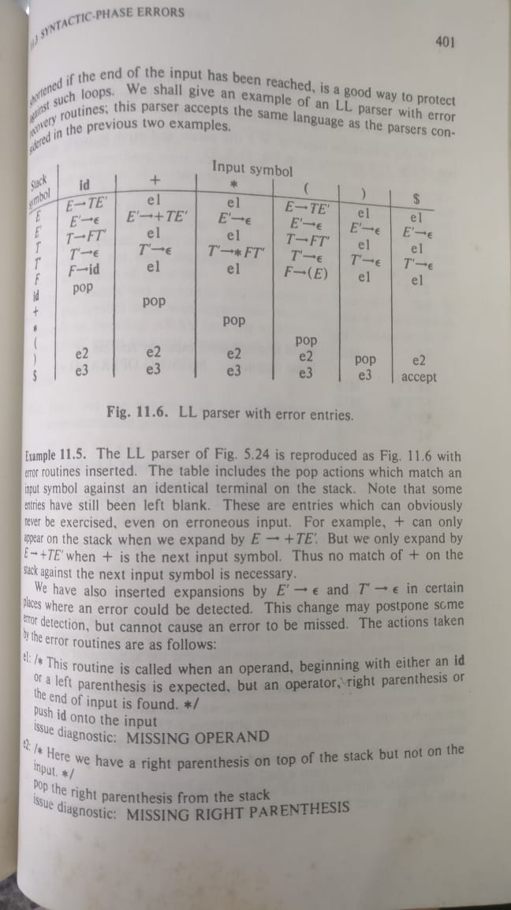
Syntax Analysis

Slide 41
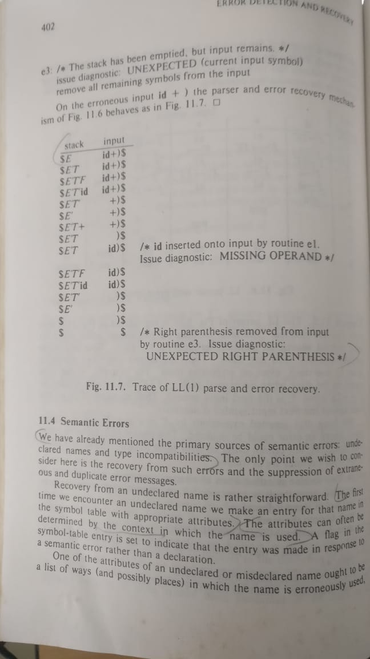
Syntax Analysis

Slide 42
Consider the grammar defined by the following production rules, with two operators * and +
S→T∗P
T→U|T∗U
P→Q+P|Q
Q→id
U→id
Which one of the following is TRUE?
A. + is left associative and * is right associative
B. * is left associative and + is right associative
C. Both + and * are right associative
D. Both + and * are left associative
Syntax Analysis

Slide 43
The grammar A→AA|(A)|ε is not suitable for predictive-parsing because the grammar is
A. ambiguous
B. left recursive
C. right recursive
D. an operator grammar
Syntax Analysis

Slide 44
The grammar S→aSa|bS|c is
A. LL(1) but not LR(1)
B. LR(1) but not LR(1)
C. Both LL(1) and LR(1)
D. Neither LL(1) nor LR(1)
Syntax Analysis

Slide 45
Consider the following grammar:
S→FR
R→∗S|ε
F→id
In the predictive parser table, M, of the grammar the entries M[S,id]M[S,id] and M[R,$]M[R,$] respectively.
A. {S→FR}{S→FR} and {R→ε}{R→ε}
B.{S→FR}{S→FR} and {}{}
C.{S→FR}{S→FR} and {R→∗S}{R→∗S}
D.{F→id}{F→id} and {R→ε}{R→ε}
Syntax Analysis

